Slide 1
Team106online
Sprint 4

Slide 2
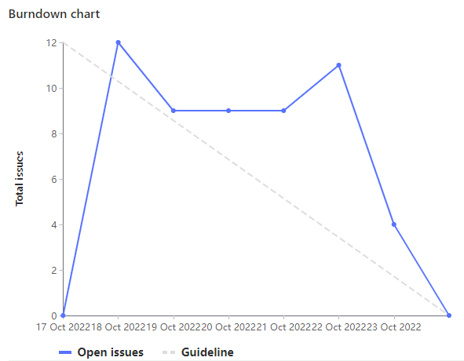
Sprint Progress

Slide 3
What Went Well
What To be Done Differently
Researching and learning new technology
Methodology of setting up the website from the bottom (setting up a basic flask app) to the top (then setting up the NGINX and then hosting on Azure)
Start working on the tasks earlier
Always have two meetings to go over sprint progress.

Slide 4
Team Member: Rehan Nagoor
Work Highlights
Total 21 points
Setup basic flask server
Helped creating the install script
Helped create the documentation with Ivan and Salman

Slide 5
Team Member: Samuel Guilbeault
Work Highlights
Refactor of project structure to support server and web
Configuration and initial spin-up of web server
Configuration and initial spin-up of flask server
Total weight of 20

Slide 6
Team Member: Hyrum Nantais
Work Highlights
Total 26 points
Setup nginx to serve react
Create Setup script with Caleb and others
Configured and deployed Azure VM

Slide 7
Team Member: Muhammad Salmaan
Work Highlights
This week my weight for the total work done was 21 weights.
My highlight :This week I did research on tools which were supposed to be used, I learned about tailwind and how to implement it for UI as well as I helped with readme/docs.
Had team meetings and reviews this week for everything done thus far..

Slide 8
Team Member: Parker Carnegie
Work Highlights
Created documentation for web server with instructions to install/run server (Wiki/README)
Researched React, Asure and NGNIX
Helped create simple HTML website template

Slide 9
Team Member: Alif Merchant
Work Highlights
Total Weight of 21
Researched technologies used in stack
Project refactoring and deployment

Slide 10
Team Member: Ivan Odiel Magtangob
Work Highlights
Total Weights: 21
Updated README + GitLab documentation
Helped with setting up installation script
Researched technologies used in tech stack

Slide 11
Team Member: Caleb Beere
Work Highlights:
Total 26 points
Created install script with Hyrum and others
Setup basic postCSS + tailwindCSS configurations for frontend production builds
Setup basic react project template and home page

Slide 12

Demo time!

